Slide 1
THE ECONOMY
Introduction
01
Economic Problem
02
Purpose of the economy
03
Supply & Demand Introduction
04
Economic Styles
Traditional & Planned

Slide 2
THE PROBLEM
Genesis 1:27-28. ²⁷ So God created mankind in his own image, in the image of God he created them; male and female he created them.²⁸ God blessed them and said to them, “Be fruitful and increase in number; fill the earth and subdue it. Rule over the fish in the sea and the birds in the sky and over every living creature that moves on the ground.”
Why money was invented
To simplify Trading Methods
Where does money come from?
The central bank manufactures fiduciary money and has a monopoly on the issuance of legal tender currency; it also steers the money creation process by setting the price of money.
Who is in control?
Economic systems decides who and what holds the final say in how things are run in the economy. See next slides.

Slide 3
MONEY PURPOSES
Scarcity- the state of being scarce or in short supply
Method of trade
Measurement of worth
Standard of debt
Maintaining Worth

Slide 4






THE FLOW OF MONEY

Slide 5
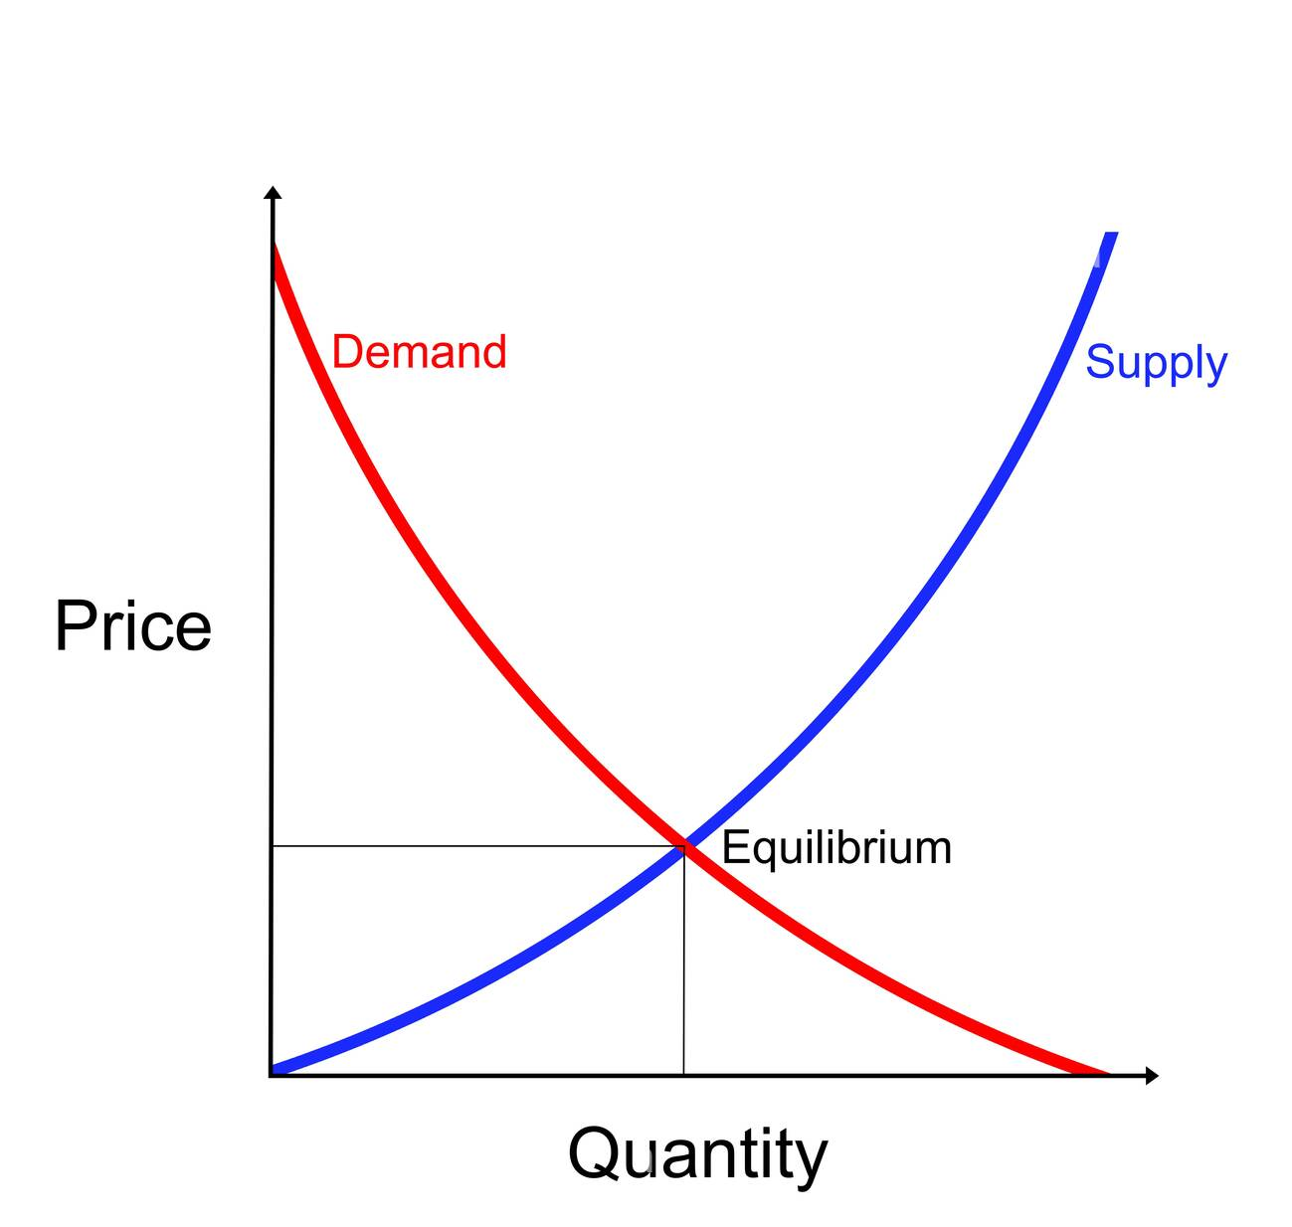
SUPPLY & DEMAND
Make a big impact with our professional slides and charts

Slide 6
PURPOSE OF THE ECONOMY
Answering the following questions:
What products & services is needed, and how much of it?
How should these products and services be produced?
For who is the products and services produced?
Managing the User, Producer & Dealer

Slide 7
Economic Systems
Make a big impact with our professional slides and charts
Capitalism
Those with the most money holds the power of SAY
Communism
Those who does all the work holds the power of SAY
Socialism
Society holds the power of SAY
Calvinism
God holds the power of SAY

